Slide 1
Database Overview
S511 Session 2, IU-SLIS

Slide 2
Outline
Database
  What, Why, How
Evolution of Database
  File System
  Data Models
    Hierarchical
    Network
    Relational
    Entity-Relationship
    Object-Oriented
  Web Database
S511 Session 2, IU-SLIS

Slide 3
Database: What
Database
  is collection of related data and its metadata organized in a structured format
  for optimized information management
Database Management System (DBMS)
  is a software that enables easy creation, access, and modification of databases
  for efficient and effective database management
Database System
  is an integrated system of hardware, software, people, procedures, and data
  that define and regulate the collection, storage, management, and use of data within a database environment
S511 Session 2, IU-SLIS
Notes:
End user data – raw facts of interests to the end user
Metadata – description of data characteristics and relationships
Organization of data helps:
improve data accuracy
improve timely access
correlation and comparison
DBMS: a collection of programs that manages the database structure, control access to data
- Makes data management more efficient and effective
- Query language allows quick answers to ad hoc queries
- Provides better access to more and better-managed data
- Promotes integrated view of organization’s operations
- Reduces the probability of inconsistent data

Slide 4
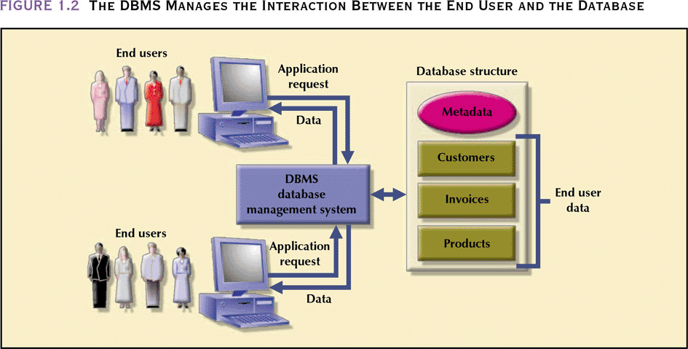
Database Management System
- manages interaction between end users and database
Database Systems: Design, Implementation, & Management: Rob & Coronel
S511 Session 2, IU-SLIS

Slide 5
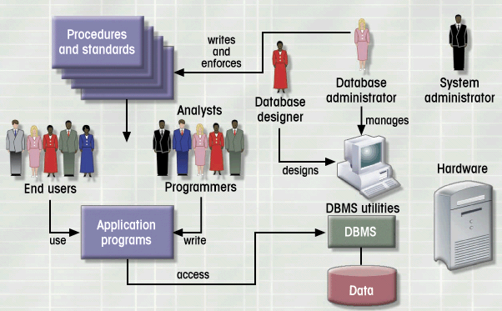
Database System Environment
Hardware
Software
- OS
- DBMS
- Applications
People
Procedures
Data
Database Systems: Design, Implementation, & Management: Rob & Coronel
S511 Session 2, IU-SLIS

Slide 6
Database: Why
Purpose of Database
  Optimizes data management
  Transforms data into information
Importance of Database Design
  Defines the database’s expected use
    different approach needed for different types of databases
  Avoid data redundancy & ensure data integrity
    data is accurate and verifiable
  Poorly designed database generates errors
    leads to bad decisions
    can lead to failure of organization
Functions of DBMS/Database System
  Stores data and related data entry forms, report definitions, etc.
  Hides the complexities of relational database model from the user
    facilitates the construction/definition of data elements and their relationships
    enables data transformation and presentation
  Enforces data integrity
  Implements data security management
    access, privacy, backup & restoration
S511 Session 2, IU-SLIS
Notes:
Importance of Good Design
Poor design results in unwanted data redundancy
Poor design generates errors leading to bad decisions
Practical Approach
Focus on principles and concepts of database design
Importance of logical design

Slide 7
Database: How
Planning & Analysis
  Assess
    Goal of the organization
    Database environment
      existing hardware, software, raw data, data processing procedures
  Identify
    Database needs
      what database can do to further the goal of the organization
    User needs and characteristics
      who the users are, what they want to do, how they envision doing it
    Database system requirements
      what the database system should do to satisfy the database and user needs
Design
  From conceptual design to a detailed system specification
Implementation
  Create the database
Maintenance
  Troubleshoot, update, streamline the database
S511 Session 2, IU-SLIS

Slide 8
Business Rules
What
  Brief, precise, and unambiguous descriptions of operations in an organization
    based on policies, procedures, or principles within a specific organization
    help to create and enforce actions within that organization’s environment
    apply to any organization that stores and uses data to generate information
Why
  Enhance understanding & facilitate communication
    Standardize company’s view of data
    Constitute a communications tool between users and designers
    Allow designer to understand business process as well as the nature, role, and scope of data
  Promote creation of an accurate data model
How (sources)
  Interviews
    Company managers
    Policy makers
    Department managers
    End users
  Written documentation
    Procedures, Standards, Operations manuals
  Observation
    Business operations
S511 Session 2, IU-SLIS

Slide 9
Database: User-centered
Perspective
  The user is always right. If there is a problem with the use of the system, the system is the problem, not the user.
Compliance
  The user has the right to a system that performs exactly as promised.
Instruction
  The user has the right to easy-to-use instructions (user guides, online or contextual help, error messages) for understanding and utilizing a system to achieve desired goals and recover efficiently and gracefully from problem situations.
Usability
  The user should be the master of software and hardware technology, not vice-versa. Products should be natural and intuitive to use.
S511 Session 2, IU-SLIS

Slide 10
Database: Data Models
Importance
  Abstraction of complex real-world data structures in relative simple (graphical) representations
  Facilitate interaction among the designer, the applications programmer, and the end user
Basic Building Blocks
  Entity
    thing about which data are to be collected and stored
  Attribute
    a characteristic of an entity
  Relationship
    describes an association among entities
  Constraint
    restrictions placed on the data
S511 Session 2, IU-SLIS

Slide 11
Evolution of Data Models
Timeline
1960s
1970s
1980s
1990s
2000+
File-based
Hierarchical
Object-oriented
Network
Relational
Web-based
Entity-Relationship
S511 Session 2, IU-SLIS

Slide 12
Database: Historical Roots
Manual File System
  to keep track of data
  used tagged file folders in a filing cabinet
  organized according to expected use
    e.g. file per customer
  easy to create, but hard to
    locate data
    aggregate/summarize data
Computerized File System
  to accommodate the data growth and information need
  manual file system structures were duplicated in the computer
  Data Processing (DP) specialists wrote customized programs to
    write, delete, update data (i.e. management)
    extract and present data in various formats (i.e. report)
S511 Session 2, IU-SLIS

Slide 13
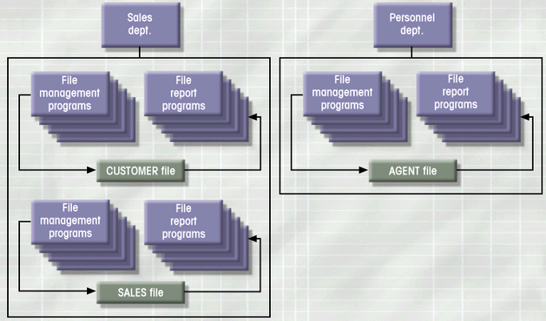
File System: Example
Database Systems: Design, Implementation, & Management: Rob & Coronel
S511 Session 2, IU-SLIS

Slide 14
File System: Weakness
Weakness
  “Islands of data” in scattered file systems.
Problems
  Duplication
    same data may be stored in multiple files
  Inconsistency
    same data may be stored by different names in different format
  Rigidity
    requires customized programming to implement any changes
    cannot do ad-hoc queries
Implications
  Waste of space
  Data inaccuracies
  High overhead of data manipulation and maintenance
S511 Session 2, IU-SLIS

Slide 15
File System: Problem Case
CUSTOMER file
AGENT file
SALES file
A_Name (15 char)
A_Name (20 char)
AGENT (20 char)
Carol Johnson
Carol T. Johnson
Carol J. Smith
- inconsistent field name, field size
- inconsistent data values
- data duplication
S511 Session 2, IU-SLIS

Slide 16
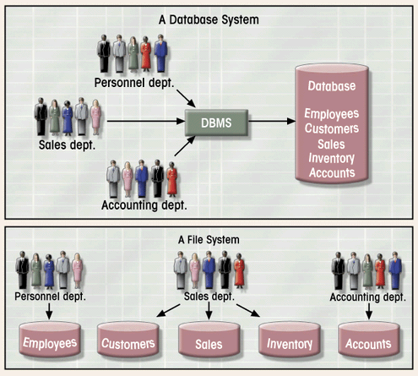
Database System vs. File System
Database Systems: Design, Implementation, & Management: Rob & Coronel
S511 Session 2, IU-SLIS

Slide 17
Hierarchical Database
Background
  Developed to manage large amount of data for complex manufacturing projects
  e.g., Information Management System (IMS)
    IBM-Rockwell joint venture
    clustered related data together
    hierarchically associated data clusters using pointers
Hierarchical Database Model
  Assumes data relationships are hierarchical
    One-to-Many (1:M) relationships
      Each parent can have many children
      Each child has only one parent
  Logically represented by an upside down tree
S511 Session 2, IU-SLIS

Slide 18
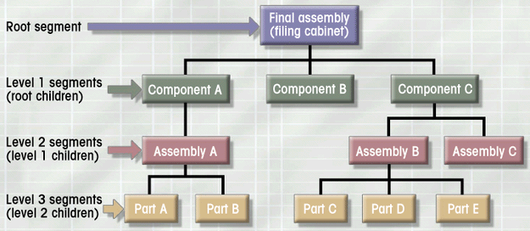
Hierarchical Database: Example
Database Systems: Design, Implementation, & Management: Rob & Coronel
S511 Session 2, IU-SLIS

Slide 19
Hierarchical Database: Pros & Cons
Advantages
  Conceptual simplicity
    groups of data could be related to each other
    related data could be viewed together
  Centralization of data
    reduced redundancy and promoted consistency
Disadvantages
  Limited representation of data relationships
    did not allow Many-to-Many (M:N) relations
  Complex implementation
    required in-depth knowledge of physical data storage
  Structural Dependence
    data access requires physical storage path
  Lack of Standards
    limited portability
S511 Session 2, IU-SLIS

Slide 20
Network Database
Objectives
  Represent more complex data relationships
  Improve database performance
  Impose a database standard
Network Database Model
  Similar to Hierarchical Model
    Records linked by pointers
  Composed of sets
    Each set consists of owner (parent) and member (child)
  Many-to-Many (M:N) relationships representation
    Each owner can have multiple members (1:M)
    A member may have several owners
S511 Session 2, IU-SLIS

Slide 21
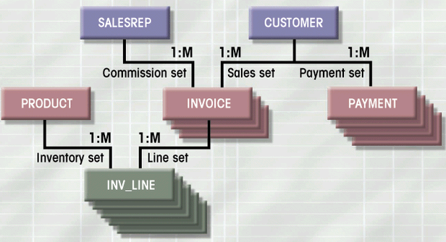
Network Database: Example
Database Systems: Design, Implementation, & Management: Rob & Coronel
S511 Session 2, IU-SLIS

Slide 22
Network Database: Pros & Cons
Advantages
  More data relationship types
  More efficient and flexible data access
    “network” vs. “tree” path traversal
  Conformance to standards
    enhanced database administration and portability
Disadvantages
  System complexity
    require familiarity with the internal structure for data access
  Lack of structural independence
    small structural changes require significant program changes
S511 Session 2, IU-SLIS
Notes:
disadvantages left over from hierarchical model

Slide 23
Relational Database
Problems with legacy database systems
  Required excessive effort to maintain
    Data manipulation (programs) too dependent on physical file structure
  Hard to manipulate by end-users
    No capacity for ad-hoc query (must rely on DB programmers).
Evolution in Data Organization
  E. F. Codd’s Relational Model proposal
    Separated the notion of physical representation (machine-view)
    from logical representation (human-view)
    Considered ingenious but computationally impractical in 1970
  Relational Database Model
    Dominant database model of today
    Eliminated pointers and used tables to represent data
    Tables
      flexible logical structure for data representation
      a series of row/column intersections
      related by sharing common entity characteristic(s)
S511 Session 2, IU-SLIS

Slide 24
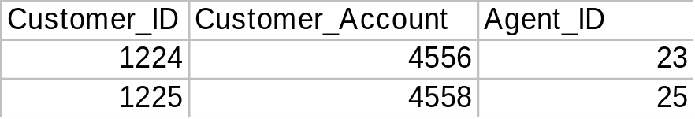
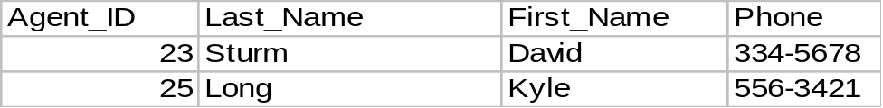
Relational Database: Example
Provides a logical “human-level” view of the data and associations among groups of data (i.e., tables)
S511 Session 2, IU-SLIS

Slide 25
Relational Database: Pros & Cons
Advantages
  Structural independence
    Separation of database design and physical data storage/access
    Easier database design, implementation, management, and use
  Ad hoc query capability with Structured Query Language (SQL)
    SQL translates user queries to codes
Disadvantages
  Substantial hardware and system software overhead
    more complex system
  Poor design and implementation is made easy
    ease-of-use allows careless use of RDBMS
S511 Session 2, IU-SLIS

Slide 26
Entity Relationship Model
Peter Chen’s Landmark Paper in 1976
  “The Relationship Model: Toward a Unified View of Data”
  Graphical representation of entities and their relationships
Entity Relationship (ER) Model
  Based on Entity, Attributes & Relationships
    Entity is a thing about which data are to be collected and stored
      e.g. EMPLOYEE
    Attributes are characteristics of the entity
      e.g. SSN, last name, first name
    Relationships describe an associations between entities
      i.e. 1:M, M:N, 1:1
  Complements the relational data model concepts
    Helps to visualize structure and content of data groups
      entity is mapped to a relational table
    Tool for conceptual data modeling (higher level representation)
  Represented in an Entity Relationship Diagram (ERD)
    Formalizes a way to describe relationships between groups of data
S511 Session 2, IU-SLIS

Slide 27
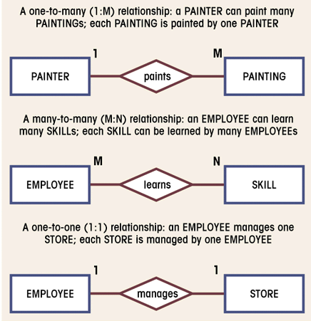
E-R Diagram: Chen Model
Entity
  represented by a rectangle with its name in capital letters.
Relationships
  represented by an active or passive verb inside the diamond that connects the related entities.
Connectivities
  i.e., types of relationship
  written next to each entity box.
Database Systems: Design, Implementation, & Management: Rob & Coronel
S511 Session 2, IU-SLIS

Slide 28
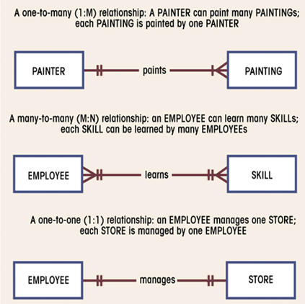
E-R Diagram: Crow’s Foot Model
Entity
  represented by a rectangle with its name in capital letters.
Relationships
  represented by an active or passive verb that connects the related entities.
Connectivities
  indicated by symbols next to entities.
    2 vertical lines for 1
    “crow’s foot” for M
Database Systems: Design, Implementation, & Management: Rob & Coronel
S511 Session 2, IU-SLIS

Slide 29
E-R Model: Pros & Cons
Advantages
  Exceptional conceptual simplicity
    easily viewed and understood representation of database
    facilitates database design and management
  Integration with the relational database model
    enables better database design via conceptual modeling
Disadvantages
  Incomplete model on its own
    Limited representational power
      cannot model data constraints not tied to entity relationships
        e.g. attribute constraints
      cannot represent relationships between attributes within entities
    No data manipulation language (e.g. SQL)
  Loss of information content
    Hard to include attributes in ERD
S511 Session 2, IU-SLIS

Slide 30
Object-Oriented Database
Semantic Data Model (SDM)
  Modeled both data and their relationships in a single structure (object)
    Developed by Hammer & McLeod in 1981
Object-oriented concepts became popular in 1990s
  Modularity facilitated program reuse and construction of complex structures
  Ability to handle complex data types (e.g. multimedia data)
Object-Oriented Database Model (OODBM)
  Maintains the advantages of the ER model but adds more features
  Object = entity + relationships (between & within entity)
    consists of attributes & methods
      attributes describe properties of an object
      methods are all relevant operations that can be performed on an object
    self-contained abstraction of real-world entity
  Class = collection of similar objects with shared attributes and methods
    e.g. EMPLOYEE class = (employ1 object, employ2 object, …)
    organized in a class hierarchy
      e.g. PERSON > EMPLOYEE, CUSTOMER
  Incorporates the notion of inheritance
    attributes and methods of a class are inherited by its descendent classes
S511 Session 2, IU-SLIS

Slide 31
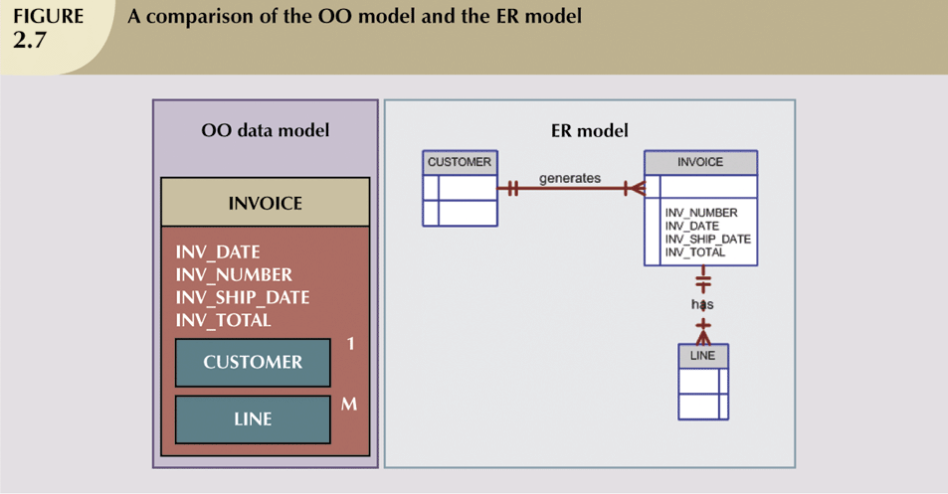
OO Database Model vs. E-R Model
OODBM:
- can accommodate relationships within a object
- objects to be used as building blocks for autonomous structures
Database Systems: Design, Implementation, & Management: Rob & Coronel
S511 Session 2, IU-SLIS

Slide 32
Object-Oriented Database: Pros & Cons
Advantages
  Semantic representation of data
    fuller and more meaningful description of data via object
  Modularity, reusability, inheritance
  Ability to handle
    complex data
    sophisticated information requirements
Disadvantages
  Lack of standards
    no standard data access method
  Complex navigational data access
    class hierarchy traversal
  Steep learning curve
    difficult to design and implement properly
  More system-oriented than user-centered
  High system overhead
    slow transactions
S511 Session 2, IU-SLIS

Slide 33
Web Database
Internet is emerging as a prime business tool
  Shift away from models (e.g. relational vs. O-O)
  Emphasis on interfacing with the Internet
Characteristics of “Internet age” databases
  Flexible, efficient, and secure Internet access
  Support for complex data types & relationships
  Seamless interfaces with multiple data sources and structures
  Ease of use for end-user, database architect, and database administrator
    Simplicity of conceptual database model
    Many database design, implementation, and application development tools
    Powerful DBMS GUI
S511 Session 2, IU-SLIS

Slide 34
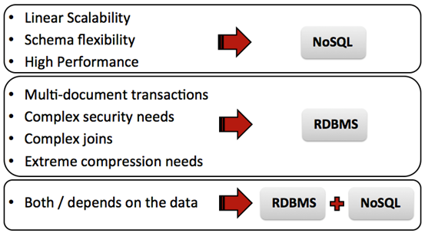
NoSQL
NoSql is not literally “no sql”. They are non relational data stores.
Next Generation Databases being non-relational, distributed, open-source and horizontally scalable have become a favorite back end storage for cloud community . High performance is the driving force.

Slide 35
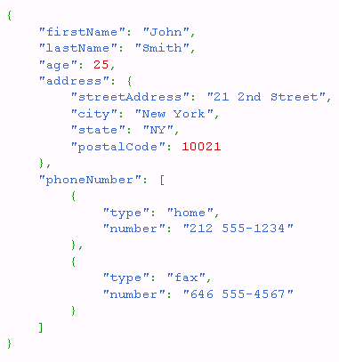
NoSQL
Pros
  open source (Cassandra, CouchDB, Hbase, MongoDB, Redis)
  Elastic scaling
  Key-value pairs, easy to use
  Useful for statistical and real-time analysis of growing lists of elements (tweets, posts, comments)
Cons
  Security (No ACID: ACID (Atomicity, Consistency, Isolation, Durability)
  No indexing support
  Immature
  Absence of standardization
S511 Session 2, IU-SLIS

